Slide 1
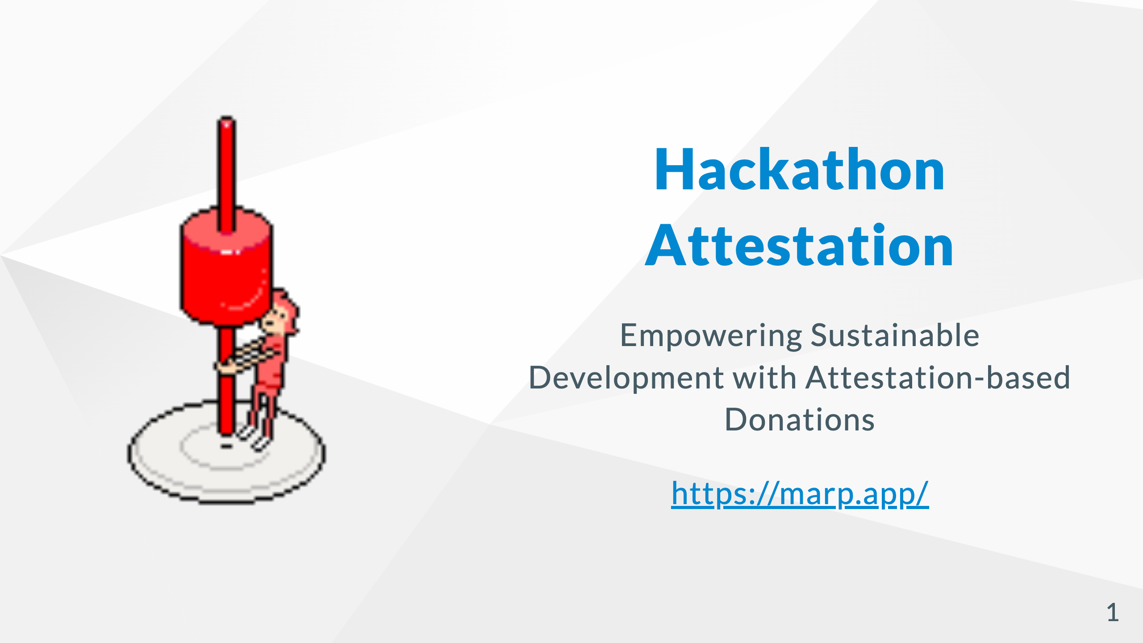
https://eth-global-tokyo-chi.vercel.app/
Notes:
Our product, named Hackathon Attestation, strives to introduce a fresh ecosystem that strengthens ongoing innovation and teamwork after hackathon events, promoting growth and collaboration even when the event has finished.

Slide 2
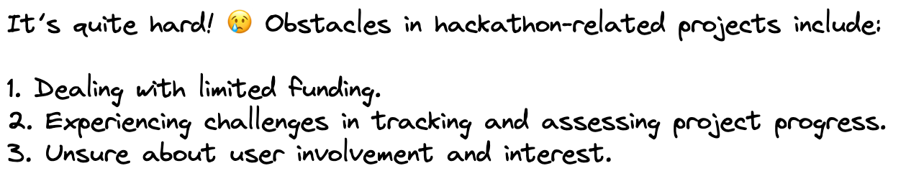
Notes:
It’s quite hard! 😢 Obstacles in hackathon-related projects include: 1. Dealing with limited funding. 2. Experiencing challenges in tracking and assessing project progress. 3. Unsure about user involvement and interest.

Slide 3

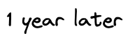
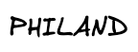
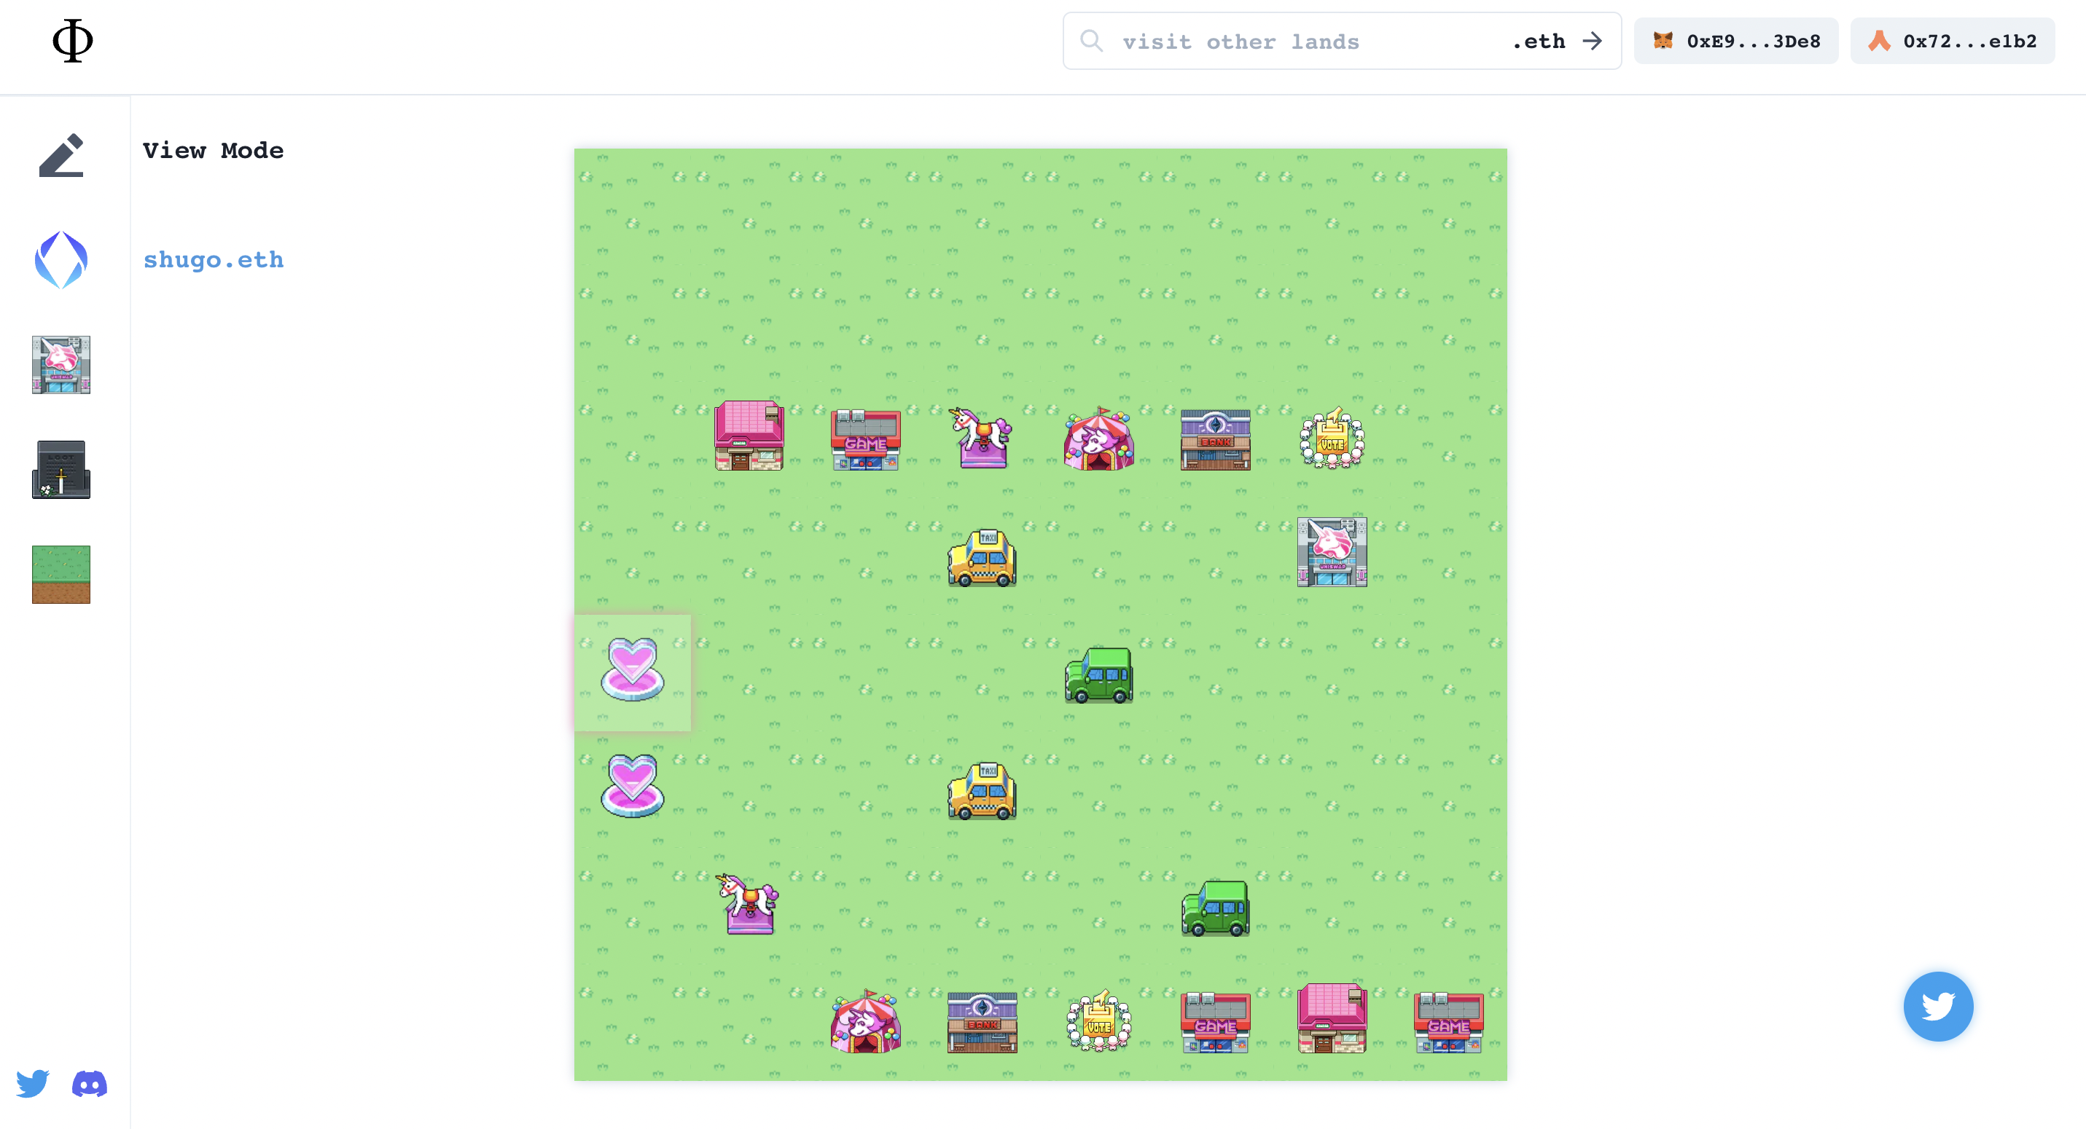


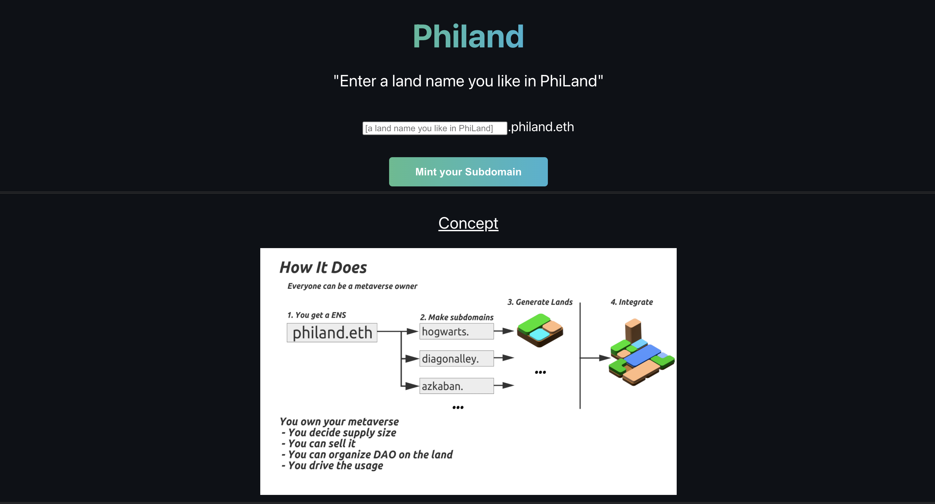
NFT HACK2022
https://ethglobal.com/showcase/phi-hs50f
BUILDQUEST
https://ethglobal.com/showcase/phi-land-2f6hf
Notes:
A year ago, I joined a hackathon too. Luckily, I formed a team and made the most of the event’s opportunity. With luck and dedication, our team has succeeded in collaborating until today.
Looking back, I found some crucial factors that have allowed us to keep working together so far:

Slide 4
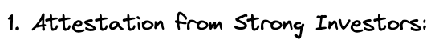



Notes:
Luckily, an angel investor noticed our project at the hackathon, leading to connections with more investors and projects, and generating valuable opportunities.
Utilizing platforms like Gitcoin, we measured user interest and expectations for our product, which helped validate our concept and gain backing.
Obtaining milestone-based grants from StarkNet eased our financial worries and let us concentrate on development, making sure the project advanced smoothly.

Slide 5

Align post-hackathon development with this situation.
Notes:
In this hackathon, my goal is to suggest a solution that simplifies establishing the positive conditions I’ve encountered, assisting other projects in flourishing and achieving success similarly.

Slide 6


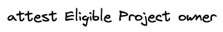
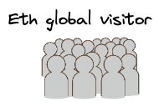

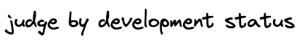


Notes:
I recommend the following steps for post-hackathon assistance:
The product owner defines milestones and associated deadlines.
Sponsors provide an endorsement for the project.
Users who want to back the project contribute donations.
Development progresses toward the established milestones.
At the deadline, a vote takes place to decide if the milestone is accomplished.
If the vote approves, the team can access the total amount of donations collected.

Slide 7

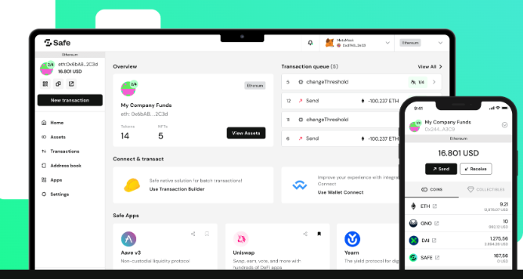

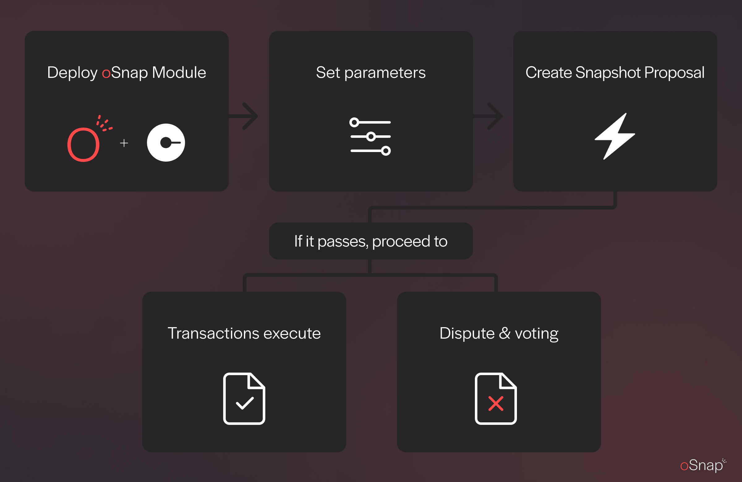



Notes:
To enable the suggested process, we’ve chosen to utilize the features of OP Attestation, oSnap, and Gnosis Safe. These tools will synergistically aid the post-hackathon development journey, guaranteeing a smooth and secure experience for both project teams and donors.

Slide 8

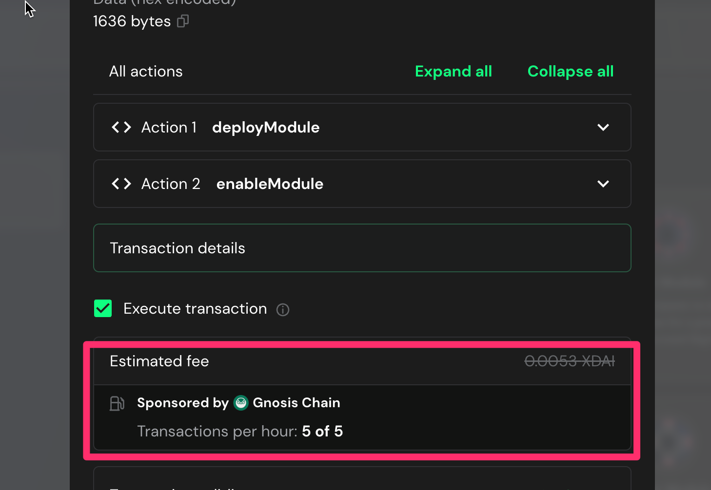
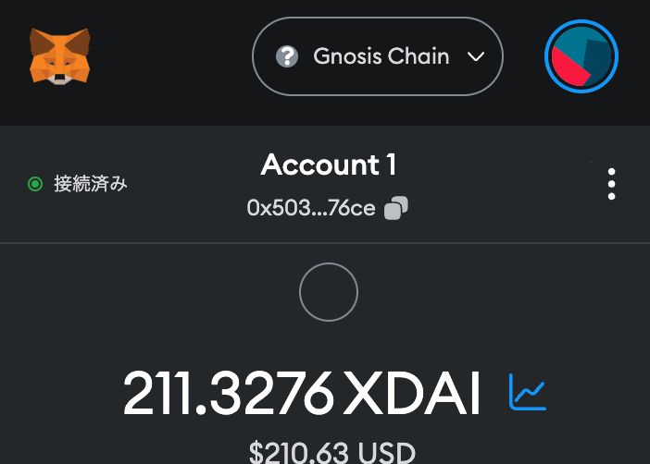
Gnosis Chain is Good Donation Environment
Build on Gnosis Chaij
Notes:
Gnosis Chain stands out in the blockchain space due to its cost-effective safe usage and stable, dollar-pegged gas pricing. These features make it a compelling choice for our system.

Slide 9
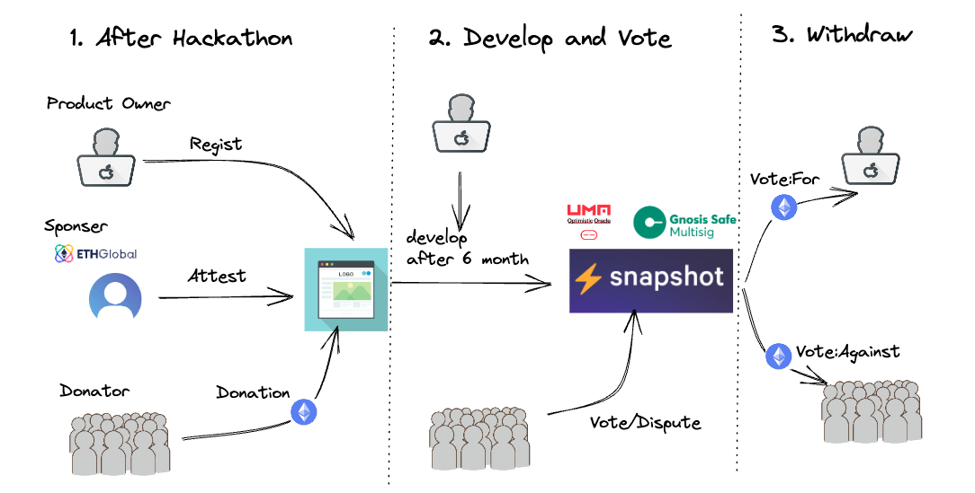
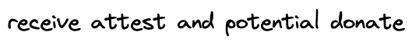
Notes:
Applying these tools to the previously mentioned flow, we can visualize the process as follows:

Slide 10

Notes:
First, let’s explain the attestation part. In this phase, the goals are setting milestones, obtaining attestations from sponsors, and receiving donations. Here’s a breakdown of each step:

Slide 11
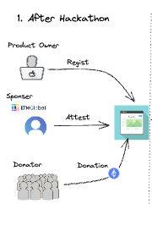
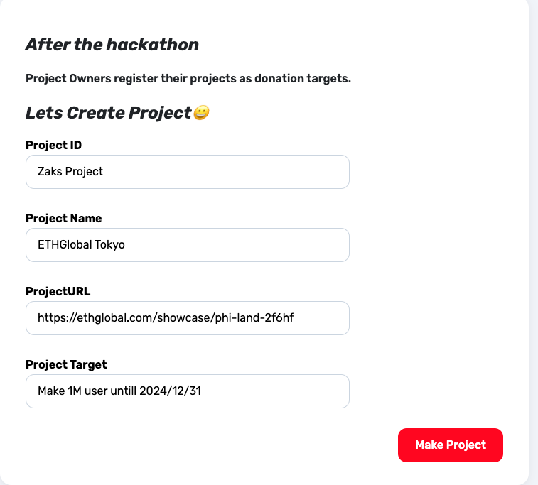

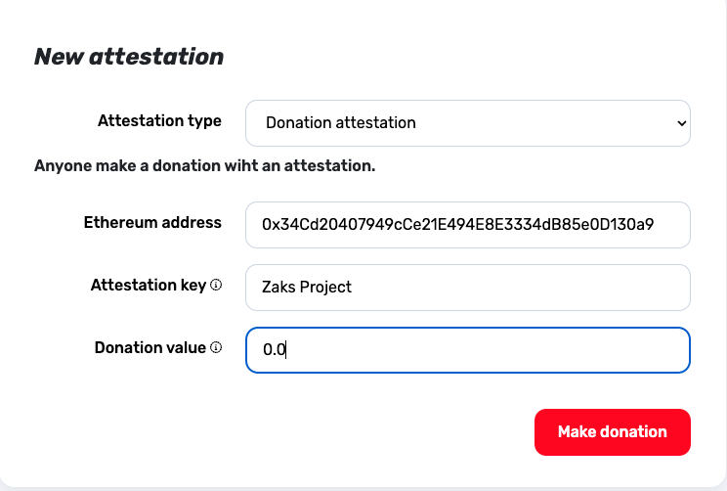
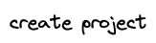
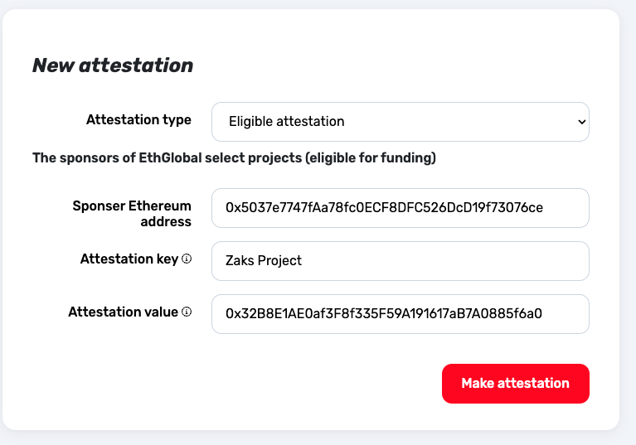

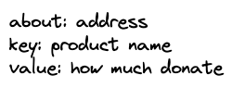
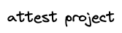
Notes:
Milestone Setting: The project owner determines the project milestones and their corresponding deadlines.
Attestation from Sponsors: Using OP Attestation, sponsors or investors can write attestations for the project using their Ethereum addresses.
Donations: With the project milestones set and attestations obtained, interested users can confidently donate to support the project’s development. These donations provide the necessary funding to help the project team work towards achieving the established milestones.

Slide 12

Notes:
The project team ought to persistently work towards accomplishing the defined milestones, securing progress and triumph for the project. Consistent communication and cooperation within the team, along with sponsors and backers, will help sustain momentum and propel the project onward.

Slide 13
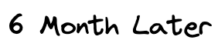
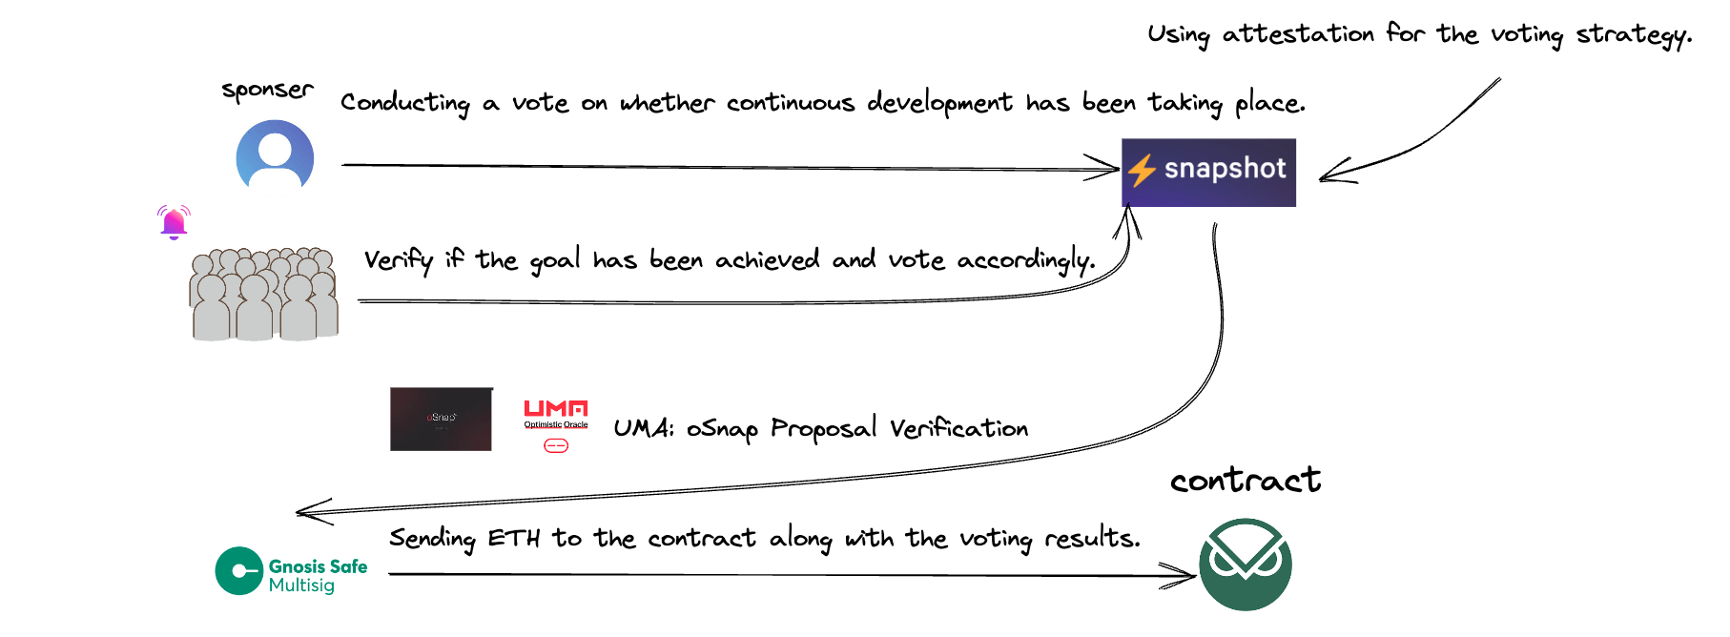
Notes:
As the deadline nears, sponsors employ oSnap’s capabilities to carry out off-chain voting for donors to decide if the milestone is reached. The voting outcomes are confirmed through UMA, and once voting is finished, funds from the Gnosis Safe, where donations were stored, are moved to a withdrawal contract.
(oSnap offers a smooth solution for handling these procedures, guaranteeing an effective and transparent system for milestone evaluation and fund distribution. This method enables project teams and backers to trust the development progress and the appropriate allocation of resources.)

Slide 14
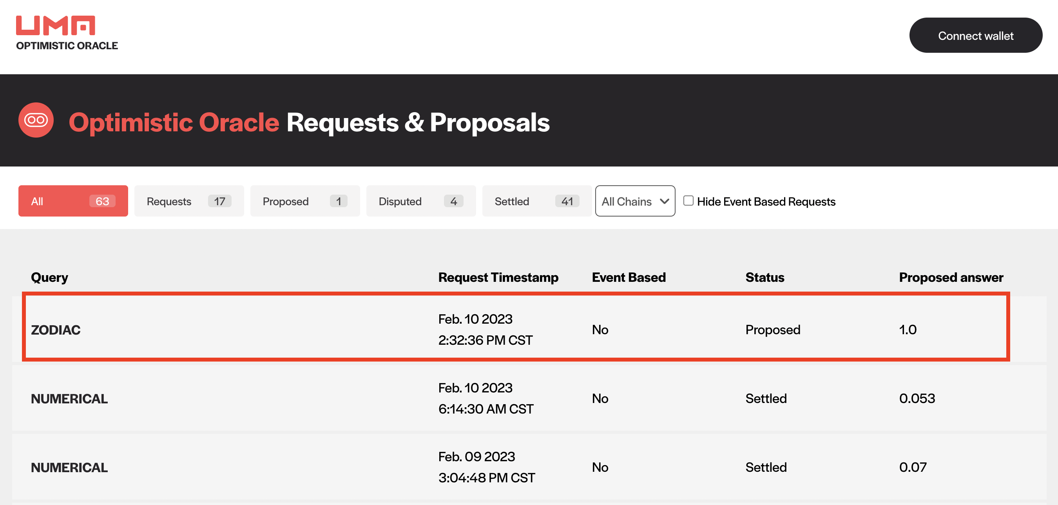
Create
Eligible
donation Osnap snapshotのスクリーンショット UMA
withdraw

Slide 15

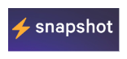
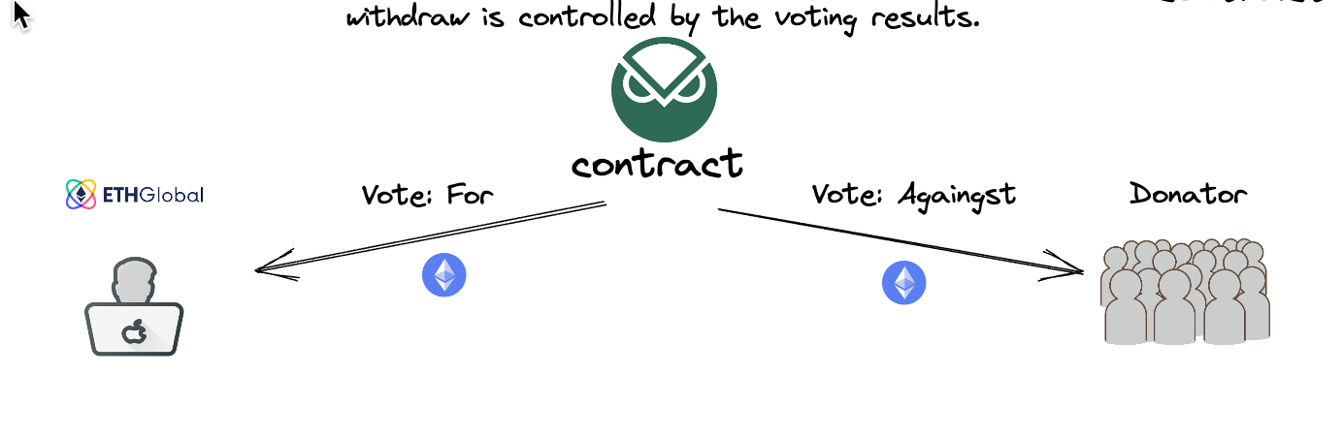
Notes:
Once the voting is complete, the funds’ eligible recipients depend on the outcomes. If the vote is successful, the product owner can obtain the donations as initially intended. However, if the vote fails, the donors can individually withdraw their contributions.
This setup guarantees a just and transparent procedure, where funds are allocated according to the project’s success in reaching milestones, and donors can trust that their donations are used effectively.

Slide 16

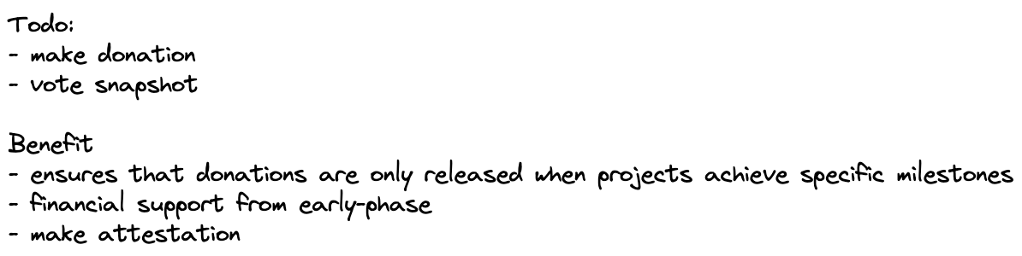

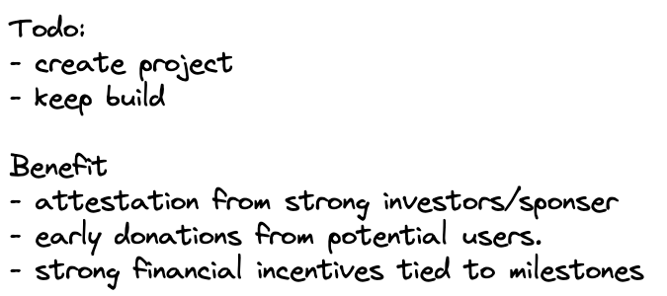
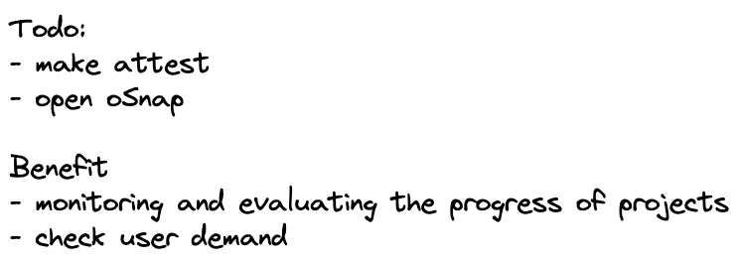
Notes:
In summary, this process offers advantages for all parties involved:
Sponsors can efficiently back and oversee projects, making sure they support promising and trustworthy endeavors. Project owners obtain the required funding and confirmation based on their performance, inspiring them to work hard and reach milestones. Donors can contribute with confidence, aware that their donations are connected to milestone achievements and can be returned if the project falls short of expectations. This system brings transparency and reassurance for donors, cultivating trust in the projects they endorse.
By implementing this process, we create a win-win situation for all parties involved, promoting successful post-hackathon project development and fostering a supportive ecosystem.

Slide 17
This product utilizes smart contracts and an efficient interface
while effectively leveraging oSnap, attestations, and gnosis-safe features
to ensure secure funds management and support post-hackathon-product.
Notes:
During this hackathon, we’ve suggested this process and focused on creating the contracts and front-end elements. We believe that hackathons generate numerous promising projects with immense potential. Our aim is to aid these projects in expanding and becoming more impactful by offering a supportive ecosystem that encourages success and guarantees transparent funding and validation. We aspire for our solution to create a substantial impact in the hackathon community and beyond.

Slide 18
OP Attestation: “Sponsors/Investors” can make attestations about project owners with their Ethereum addresses.
This process validates the project’s credibility and ensures that only trustworthy projects can receive donations.
oSnap:
Our product leverages oSnap’s benefits, such as decentralization, security, flexibility, and interoperability,
to facilitate an efficient and reliable donation system.
Donations are only released when projects “achieve specific milestones”
Gnosis Safe:
This platform enables secure funds management,
ensuring that “donations are safely” held until projects meet their milestones.
Notes:
OP Attestation: Sponsors and investors can vouch for project owners’ credibility using attestation
.oSnap establish an effective and dependable donation system by UMA based execute. Donations are disbursed only when projects reach particular milestones.
Gnosis Safe: Gnosis Safe makes sure of secure funds management, safeguarding donations until project milestones are achieved.

